Slide 1
terminal下实现简单人机五子棋
计科1704 钱非凡

Slide 2
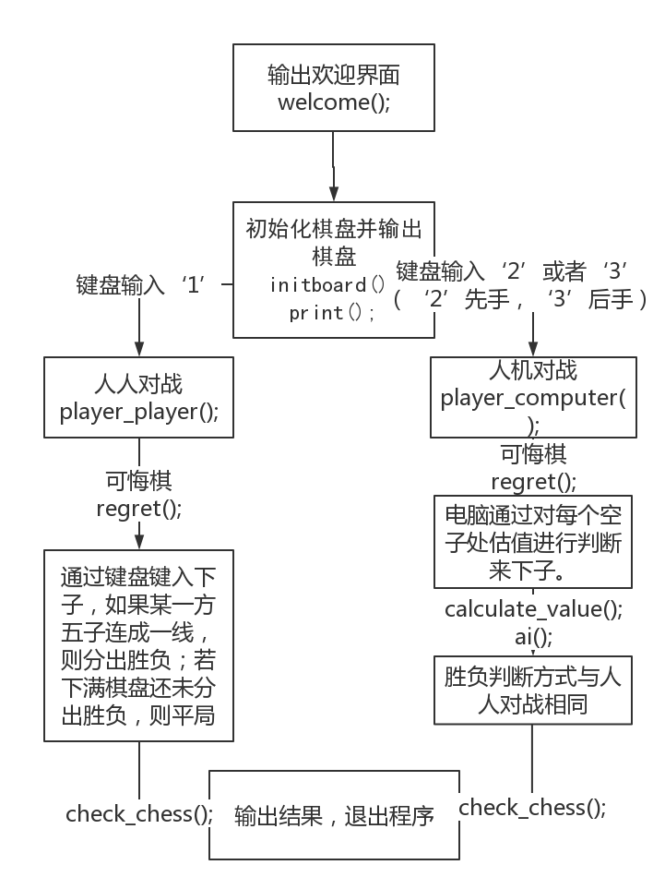

Slide 3
基本实现目标
terminal下实现简单人机五子棋
完成棋盘的基本样式
实现简单的AI

Slide 4
terminal下实现简单人机五子棋
#include <cstdio>
#include <cstdlib>
#include <cstring>
#include <ctime>
#include <random>
#include "conio.h" //检测键盘键入的函数
#define LEN 10 //棋盘大小
#define BOARD (LEN * 2 + 1) //整体大小
#define NOTCHESS check[row][col] == 0 //格子对应值的判断
#define ISWHITE check[row][col] == -1 //白子对应值的判断
#define ISBLACK check[row][col] == 1 //黑子对应值的判断
#define COVERSPACE check[row][col] = 3 //光标覆盖空格
#define COVERWHITE check[row][col] = -2 //光标覆盖白子
#define COVERBLACK check[row][col] = 2 //光标覆盖黑子
#define ISCOVERSPACE check[row][col] == 3 //光标覆盖空格的判断
#define ISCOVERWHITE check[row][col] == -2 //光标覆盖白子的判断
#define ISCOVERBLACK check[row][col] == 2 //光标覆盖黑子的判断

Slide 5
terminal下实现简单人机五子棋
void welcome(void); //欢迎界面
void init_board(void); //环境构建
void print(void); //棋盘输出
int player_computer(void); //人机
int player_player(void); //人人
int check_chess(void); //棋子布局检测
void regret(void); //悔棋
void game_over(int); //游戏结束后的判定输出
void delay(double); //延时函数
void go_to_xy(unsigned, unsigned); //将输入光标移动到指定位置
void ai(void); //电脑下子
void calculate_value(void); //计算每格的价值

Slide 6
terminal下实现简单人机五子棋
const char *board[BOARD][BOARD] = {0}; //棋盘格子样式
int check[LEN][LEN] = {0}; //格子的状态
int value[LEN][LEN] = {0}; //格子的价值
int reg[LEN * LEN][3] = {0}; //悔棋：回合下子记录
int turn = -1, order = 0; //white == -1 black == 1 | 先后手
int row = 0, col = 0, sign; //行列 | 输入记录
int count = 0; //下子数
const char *BLACK = "○", *WHITE = "●", *POS = "¤"; // UTF-8 棋子、棋盘字符
const char *LT = "┌", *TOP = "┬", *RT = "┐";
const char *LEFT = "├", *CENTER = "┼", *RIGHT = "┤";
const char *LF = "└", *FOOT = "┴", *RF = "┘";
const char *SPACE = " ";

Slide 7
terminal下实现简单人机五子棋
void welcome(){ //游戏开始界面
printf("╔═══════════════════════════════════════════════════════════════════════╗\n");
printf("║ ║\n");
printf("║ WELCOME TO PLAY ║\n");
printf("║ %d IN LINE GAME ║\n", CHESS);
printf("║ ._______________________. ║\n");
printf("║ | _____________________ | ║\n");
printf("║ | I I | Tips: ║\n");
printf("║ | I Five In I | 1. Use \'wasd\' ║\n");
printf("║ | I Line Game I | or direction keys ║\n");
printf("║ | I For Fun I | to control. ║\n");
printf("║ | I___________________I | 2. Use \'r\' to ║\n");
printf("║ !_______________________! regret. ║\n");
printf("║ ._[__________]_. 3. Use \'`\' to ║\n");
printf("║ .___|_______________|___. quit. ║\n");
printf("║ |::: ____ | ║\n");
printf("║ | ~~~~ [CD-ROM] | ║\n");
printf("║ !_____________________! ║\n");
printf("║ ║\n");
printf("║ ║\n");
printf("║ Input \'1\' to play with computer ║\n");
printf("║ Input \'2\' to play with your partner ║\n");
printf("║ ║\n");
printf("╚═══════════════════════════════════════════════════════════════════════╝\n");
printf("\033[?25l"); //隐藏光标 '\033'是'ESC'的八进制表示形式
}

Slide 8
terminal下实现简单人机五子棋
void init_board(){ //棋盘构建
for(int i = 0; i < BOARD; i++)
for(int j = 0; j < BOARD; j++)
board[i][j] = SPACE; // 先全部赋为空格
//棋盘四个角的搭建
board[0][0] = LT;
board[0][BOARD - 1] = RT;
board[BOARD - 1][0] = LF;
board[BOARD - 1][BOARD - 1] = RF;
for(int i = 2; i < BOARD - 2; i += 2){ //四边搭建
board[0][i] = TOP;
board[BOARD - 1][i] = FOOT;
board[i][0] = LEFT;
board[i][BOARD - 1] = RIGHT;
}
for(int i = 2; i < BOARD - 2; i += 2)
for(int j = 2; j < BOARD - 2;j += 2)
board[i][j] = CENTER; //非边角搭建
}

Slide 9
terminal下实现简单人机五子棋
void print(){ //打印棋盘
system("clear"); //清除欢迎界面
for(int i = 0; i < BOARD; i++){
for(int j = 0; j < BOARD; j++){
if((i - 1) % 2 == 0 && (j - 1) % 2 == 0){ //根据格子对应check[][]的值输出
int temp = check[(i - 1) / 2][(j - 1) / 2];
if(temp == 0) //打印空格
printf(" ");
else if(temp == -1) //打印白子
printf("%s ", WHITE);
else if(temp == 1) //打印黑子
printf("%s ", BLACK);
else //打印光标
printf("%s ", POS);
}
else //打印棋盘
printf("%s ", board[i][j]);
}
putchar('\n');
}
if(turn == 1) //轮到黑子
printf(" %s Black Turn", BLACK);
else //轮到白子
printf(" %s White Turn", WHITE);
printf(" Pos(%2d,%2d) Done: %d\n", row + 1, col + 1, count); //光标的位置和反悔的次数
}

Slide 10
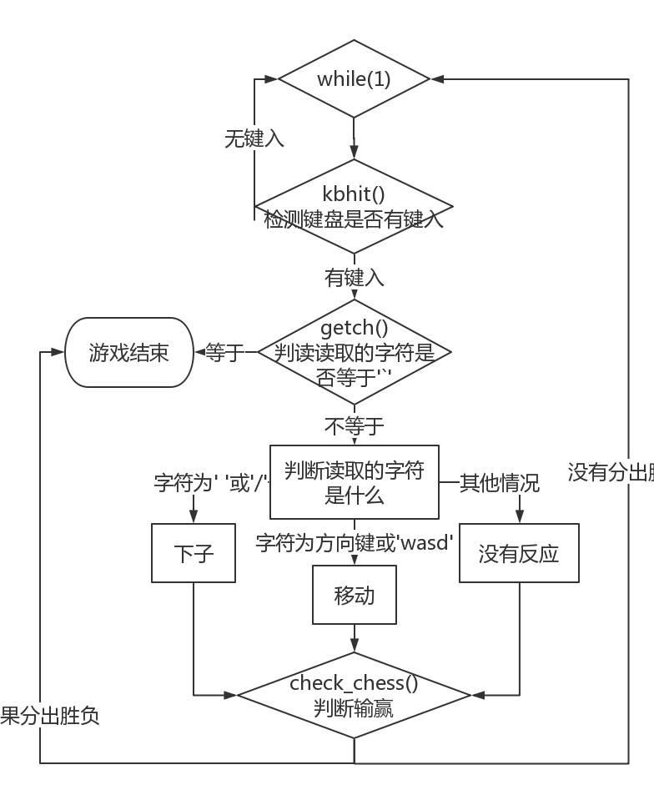
下子函数

Slide 11
terminal下实现简单人机五子棋
int player_player(){ //人人
COVERSPACE; //初始光标位置
print(); //棋盘整体输出
system("stty -echo"); //Linux命令 命令不被显示
while(1){
if(kbhit()){ //检测键盘是否有输入 有输入情况下
while((sign = getch()) != '`'){ //退出按键
if(sign == 'w' || sign == 's' || sign == 'a' || sign == 'd' || sign == ' ' || sign == 65 || sign == 66 || sign == 67 || sign == 68 || sign == '/' || sign == 'r'){
①
switch(sign){ //光标移动、下子
②
③
case 'r': //悔棋按钮
regret();
go_to_xy(2 + 2 * row, 1 + 2 * (1 + 2 * col));
printf("%s ", POS);
break;
default:
break;
}
}
break;
}
if(sign == '`') //强制退出
return 2;
}
if(count == LEN * LEN) //如果棋盘满 返回平局
return 0;
if(check_chess()) //如果一方赢了 返回分出胜负
return 1;
}
}

Slide 12
terminal下实现简单人机五子棋
①
if(sign != ' ' && sign != '/'){ //移动光标前，先把原格子复位
if(ISCOVERSPACE){
check[row][col] = 0;
go_to_xy(2 + 2 * row, 1 + 2 * (1 + 2 * col));
printf("%s ", SPACE);
}else if(ISCOVERWHITE){
check[row][col] = -1;
go_to_xy(2 + 2 * row, 1 + 2 * (1 + 2 * col));
printf("%s ", WHITE);
}else if(ISCOVERBLACK){
check[row][col] = 1;
go_to_xy(2 + 2 * row, 1 + 2 * (1 + 2 * col));
printf("%s ", BLACK);
}
}

Slide 13
terminal下实现简单人机五子棋
②
case 'w':
if(row > 0)
row--;
else
row = LEN - 1;
if(NOTCHESS)
COVERSPACE;
else if(ISWHITE)
COVERWHITE;
else if(ISBLACK)
COVERBLACK;
go_to_xy(BOARD + 1, 0);
if(turn > 0)
printf(" %s Black Turn", BLACK);
else
printf(" %s White Turn", WHITE);
printf(" Pos(%2d,%2d) Done:%2d\n", row + 1, col + 1, count);
go_to_xy(2 + 2 * row, 1 + 2 * (1 + 2 * col));
printf("%s ", POS);
break;

Slide 14
terminal下实现简单人机五子棋
③
case ' ':
if(ISCOVERSPACE){
if(turn == -1){
go_to_xy(2 + 2 * row, 1 + 2 * (1 + 2 * col));
printf("%s ", WHITE);
check[row][col] = turn;
}else if(turn == 1){
go_to_xy(2 + 2 * row, 1 + 2 * (1 + 2 * col));
printf("%s ", BLACK);
check[row][col] = turn;
}
reg[count][0] = turn;
reg[count][1] = row;
reg[count][2] = col;
turn = -turn;
count++;
go_to_xy(BOARD + 1, 0);
if(turn > 0)
printf(" %s Black Turn", BLACK);
else
printf(" %s White Turn", WHITE);
printf(" Pos(%2d,%2d) Done:%2d\n", row + 1, col + 1, count);
}
break;

Slide 15
terminal下实现简单人机五子棋
int player_computer(){ //人机
…… //和人人一样
else if(turn == -order){ //电脑下棋
ai();
if(turn == -1){
go_to_xy(2 + 2 * row, 1 + 2 * (1 + 2 * col));
printf("%s ", WHITE);
check[row][col] = turn;
}else if(turn == 1){
go_to_xy(2 + 2 * row, 1 + 2 * (1 + 2 * col));
printf("%s ", BLACK);
check[row][col] = turn;
}
reg[count][0] = turn;
reg[count][1] = row;
reg[count][2] = col;
turn = -turn;
count++;
go_to_xy(BOARD + 1, 0);
if(turn > 0)
printf(" %s Black Turn", BLACK);
else
printf(" %s White Turn", WHITE);
printf(" Pos(%2d,%2d) Done:%2d\n", row + 1, col + 1, count);
}
…… //和人人一样
}

Slide 16
terminal下实现简单人机五子棋
void ai(){ //电脑下子
calculate_value();
int sum_i[LEN * LEN], sum_j[LEN * LEN];
int max = 0, sum = 0;
for(int i = 0; i < LEN; i++)
for(int j = 0; j < LEN; j++)
if(check[i][j] == 0 && value[i][j] > max)
max = value[i][j];
for(int i = 0; i < LEN; i++){
for(int j = 0; j < LEN; j++){
if(check[i][j] == 0 && value[i][j] == max){
sum_i[sum] = i;
sum_j[sum] = j;
sum++;
}
}
}
srand((unsigned)time(0));
row = sum_i[rand() % sum];
col = sum_j[rand() % sum];
}

Slide 17
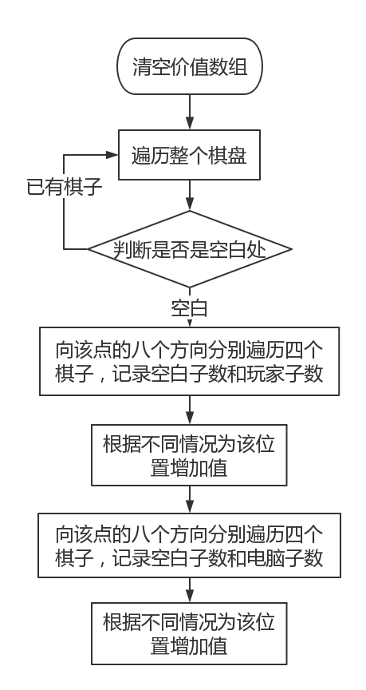
估值函数

Slide 18
terminal下实现简单人机五子棋
void calculate_value(){
//统计玩家或者电脑连成的子
int white_num = 0; //玩家连成子的个数
int black_num = 0; //AI连成子的个数
int empty_num = 0; //各方向空白位的个数
int player = order, computer = -order;
memset(value, 0, sizeof(value)); //清空评分数组
//计分
for(int i = 0; i < LEN; i++){
for(int j = 0; j < LEN; j++){
if(check[i][j] == 0){ //空白点
//遍历周围八个方向
for(int y = -1; y <= 1; y++){
for(int x = -1; x <= 1; x++){
white_num = 0;
black_num = 0;
empty_num = 0;
if(!(y == 0 && x == 0)){ //原坐标不算
//对玩家评分
①
②
empty_num = 0;
//对电脑的子评分
…… //和对玩家评分一样
}
}
}
}
}
}
}

Slide 19
terminal下实现简单人机五子棋
①
for(int k = 1; k <= 4; k++){ //每个方向延伸4个子
if(i + k * y > 0 && i + k * y < LEN && j + k * x > 0 && j + k * x < LEN && check[i + k * y][j + k * x] == player) //玩家的子
white_num++;
else if(i + k * y > 0 && i + k * y < LEN && j + k * x > 0 && j + k * x < LEN && check[i + k * y][j + k * x] == 0){ //空白位
empty_num++;
break;
}
else //出边界
break;
}
for(int k = 1; k <= 4; k++){
if(i - k * y > 0 && i - k * y < LEN && j - k * x > 0 && j - k * x < LEN && check[i - k * y][j - k * x] == player) //玩家的子
white_num++;
else if(i - k * y > 0 && i - k * y < LEN && j - k * x > 0 && j - k * x < LEN && check[i - k * y][j - k * x] == 0){ //空白位
empty_num++;
break;
}
else //出边界
break;
}

Slide 20
terminal下实现简单人机五子棋
②
if(white_num == 1)
value[i][j] += 10;
else if(white_num == 2){
if(empty_num == 1)
value[i][j] += 30;
else if(empty_num == 2)
value[i][j] += 40;
}else if(white_num == 3){
if(empty_num == 1)
value[i][j] += 60;
else if(empty_num == 2)
value[i][j] += 110;
}
else if(white_num == 4)
value[i][j] += 10100;

Slide 21
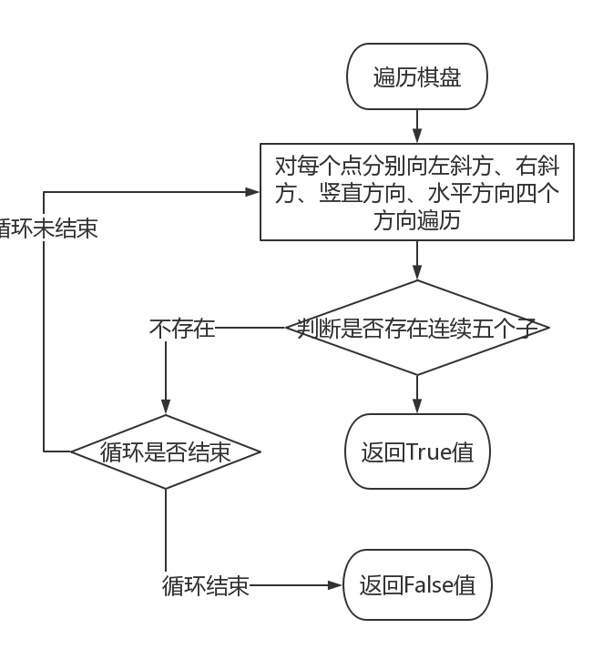
判断输赢函数

Slide 22
terminal下实现简单人机五子棋
int check_chess(){ //检测是否分出胜负
bool judge; //胜利判断
int temp; //当前格子对应值
for(int i = 0; i < LEN; i++){ //行
for(int j = 0; j < LEN; j++){ //列
if(check[i][j] != 0){
temp = check[i][j];
judge = true;
if(i <= LEN - 5 && j <= LEN - 5){ //右斜
for(int l = 1; l < 5; l++)
if(check[i + l][j + l] != temp)
judge = false;
if(judge == true)
return 1;
}
……//左斜
……//水平
……//竖直
}
}
}
return 0;
}

Slide 23
terminal下实现简单人机五子棋
void game_over(int res){ //游戏结束后的判定输出
go_to_xy(BOARD + 2, 0); //把输入光标移去底部
if(res){
if(res == 2) //s=2则平局
printf("Force Exit\n");
else if(turn == 1) //turn=1即最后一个落子的为白棋，故白棋赢
printf("\t-----%s White Won-----\n", WHITE);
else if(turn == -1) //同理
printf("\t-----%s Black Won-----\n", BLACK);
else
printf("Error!\n");
}
else
printf("\t-----Tied-----\n");
system("stty echo");
printf("\033[?25h"); //显示光标
}
void go_to_xy(unsigned x, unsigned y){ //将输入光标移动到指定位置
printf("\033[%d;%dH", x, y); //设置光标位置
}

Slide 24
terminal下实现简单人机五子棋
void regret(){ //悔棋
if(count){
count--;
turn = -turn;
row = reg[count][1]; //根据数组记录内容悔棋
col = reg[count][2];
for(int j = 0; j < 3; j++)
reg[count][j] = 0;
}
go_to_xy(BOARD + 1, 0);
if(turn > 0)
printf(" %s Black Turn", BLACK);
else
printf(" %s White Turn", WHITE);
printf(" Pos(%2d,%2d) Done:%2d\n", row + 1, col + 1, count);
go_to_xy(2 + 2 * row, 1 + 2 * (1 + 2 * col));
printf("%s ", SPACE);
COVERSPACE;
}

Slide 25
terminal下实现简单人机五子棋
int main(){
int res = 0; //游戏结束的判定状态输出
welcome(); //欢迎界面
while(1){ //选择游戏模式
sign = getch(); //读取键盘输入
if(sign == '1'){ //选择人人模式
init_board();
res = player_player();
break;
}else if(sign == '2'){ //选择人机模式（先手
init_board();
order = -1;
res = player_computer();
break;
}else if(sign == '3'){ //选择人机模式（后手
init_board();
order = 1;
res = player_computer();
break;
}
else if(sign == '`') //退出游戏
break;
else //键入其他字符不会有任何显示
continue;
}
game_over(res); //游戏结束
return 0;
}

Slide 26
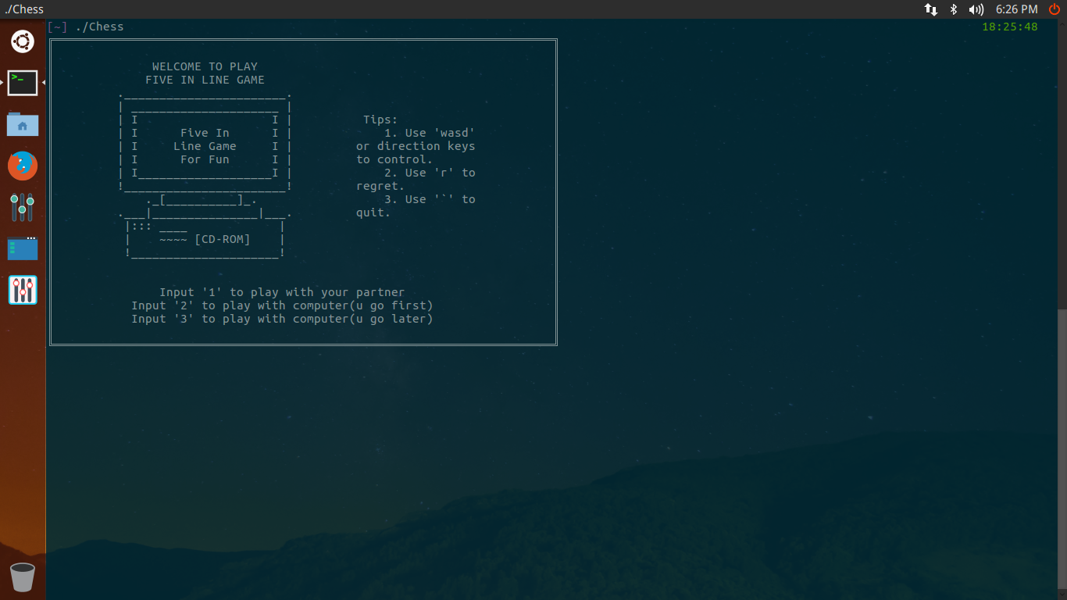

Slide 27
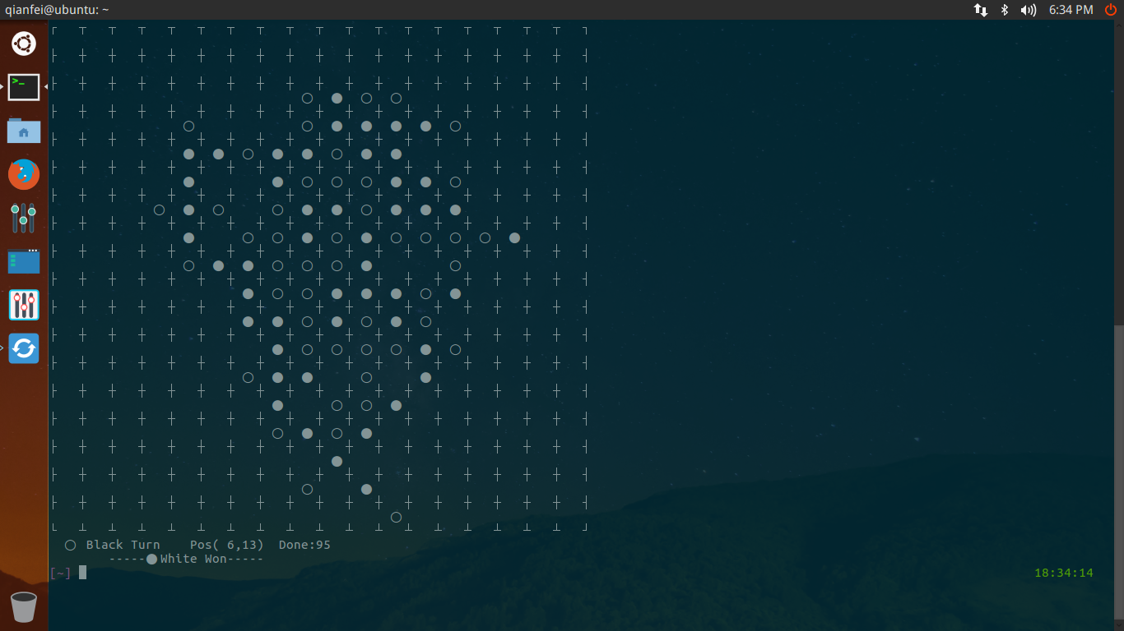

Slide 28
Thank you

